Slide 1


Chemigation / Fertigation
Lyndon Kelley
MSU Extension / Purdue University Irrigation Management Agent
St. Joseph Co. MSU Extension, 612 E. Main St., Centreville, MI 49032
Cell 269-535-0343, Kelleyl@MSU.EDU , 269-467-5511
https://engineering.purdue.edu/ABE/Engagement/Irrigation
http://www.egr.msu.edu/bae/water/
www.msue.msu.edu - find St. Joseph Co. - then hit the Irrigation button

Slide 2
Aspects of Fertigation Planning
Try to match the N uptake curve for your crop
Beware of the N source availability. Liquid N - 28% is about ½ available immediately and rest over the next week (warmer the soil the quicker)
The greater the portion applied later, the lower the chance of N loss to leaching or saturated soil volatilization.
The greater the portion applied later, the more chance you have to reflex price change for the crop or input in the plan.
Sandy irrigated soils will often provide a yield bump for each additional N split. Yield bump is minimal beyond 4 splits
Sidedress application are still important - soil aeration and increase water infiltration
Using irrigation to get the most from pesticides and nutrients
Timely application of irrigation water:
Improves incorporation of herbicides.
Improves activation of herbicides.
Improves activation/reactivation of insecticides.
Reduces nitrogen volatilization.
Maximizes yield to utilize the resources.

Slide 3
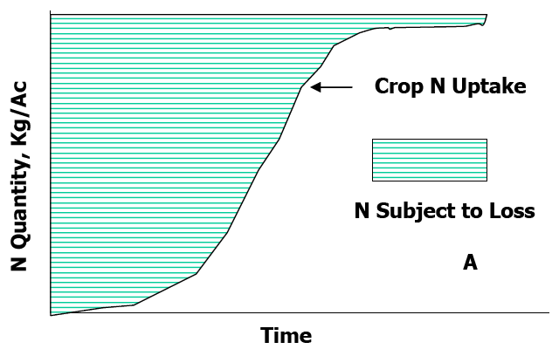
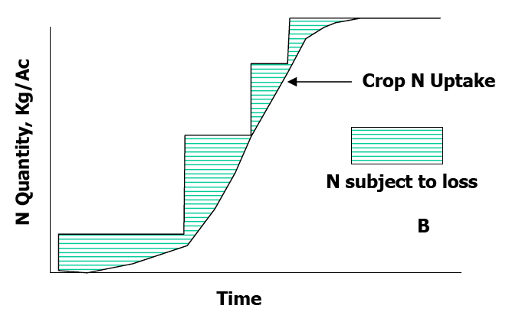
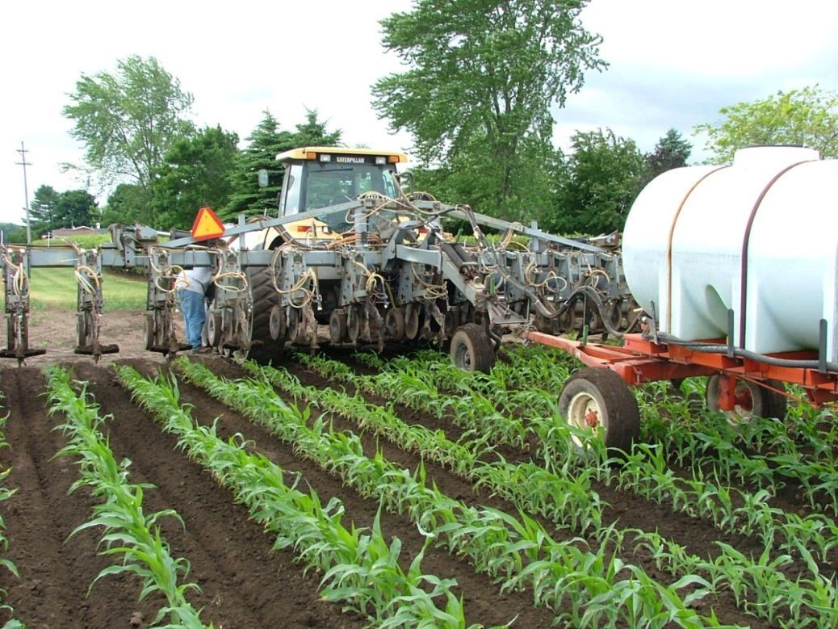
-Fertigation – Application of fertilizer via irrigation water.
-Side Dress N
The quantity of N taken up by the crop or subject to loss from a single N application (A) or split N applications (B) (Adapted from Doerge et al., 1991).

Slide 4
Use fertigation to apply the additional fertilizer need for the higher expected yield only to the irrigated part of the field
Pivot –without end gun
121 irrigated acres
39 dry acres
Pivot –with end gun
128 irrigated acres
32 dry acres
Pivot –cornering arm
150 irrigated acres
10 dry acres

Slide 5
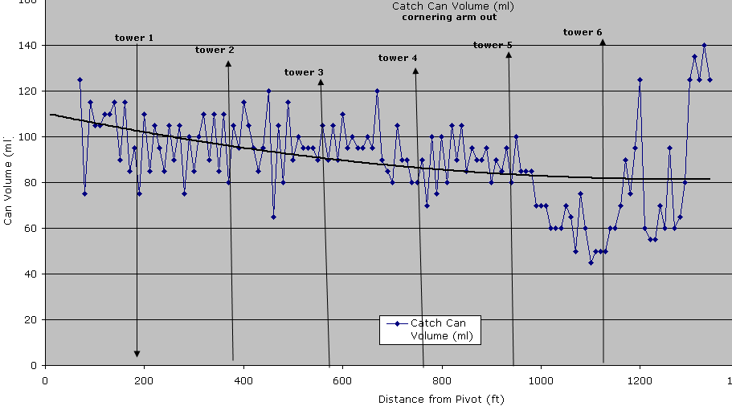
Uniform Water application essential for uniform fertigation/chemigation
Unless you know the uniformity of the system keep fertigation application to less than 25% of total plan.

Slide 6
Example N plan :
200 bu/acre irrigated commercial corn
Expected yield goal 200 bu/acre resulting in 220 lb. N recommendation
35 lbs.. in starter at planting
135 lbs.. as sidedress
50 lbs.. fertigation, 2 week prior to tassel
50 lbs.. in starter at planting
70 lbs.. as sidedress
100 lbs.. fertigation, 2 week prior to tassel
50 lbs.. in starter at planting
70 lbs.. sidedress or fertigation, knee high
50 lbs.. fertigation, waste high
50 lbs.. fertigation, 2 week prior to tassel
50 lbs.. in starter at planting
75 lbs.. sidedress or fertigation, knee high
75 lbs.. fertigation, 2 week prior to tassel
20 lbs.. fertigation, at tassel

Slide 7
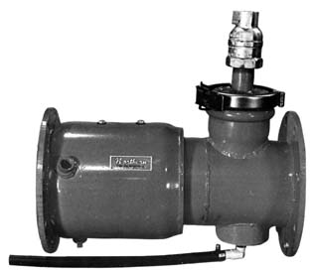

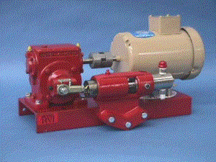

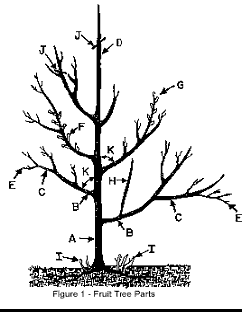

Chemigation backflow valve and injection check valve
Positive displacement injection pump
Chemigation / Fertigation Systems - Safety Interlock

Slide 8
Chemigation/Fertigation Calibration
Monitor for calculation errors or system malfunctions.
½
Shut downs
Backflows
Hose burst
Mark the supply tank level at start
Mark the supply tank level at ¼, ½, and ¾ from finish
Monitor and adjust if needed, calculate and record the actual applied amount for future decisions.
Backflow situation…. Pump, Pump, Pump as soon as possible.

